Slide 1
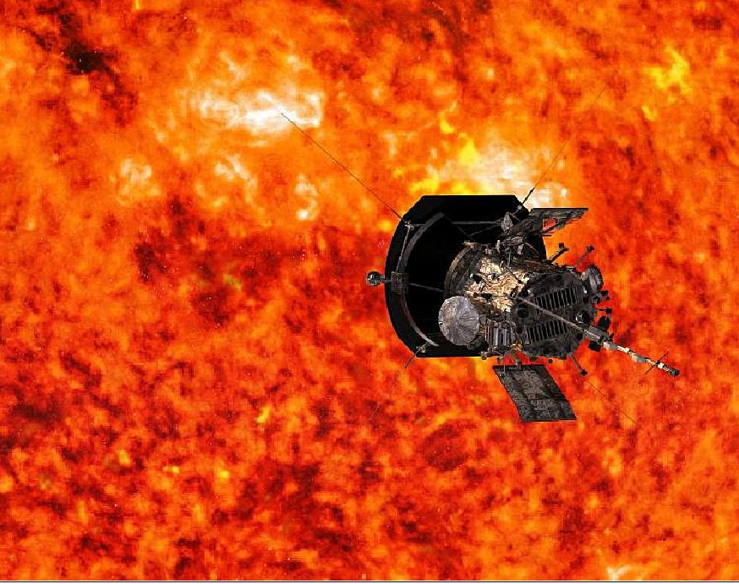
PARKER SOLAR PROBE
Earth and Space Weather Observation
Rugilandavyi B. Mubondo
M.Eng Geodesy & Geoinformatics
Hochschule Neubrandenburg

Slide 2
Introduction
NASA's historic Parker Solar Probe mission is revolutionizing our understanding of the Sun, where changing conditions can propagate out into the solar system, affecting Earth and other worlds. Parker Solar Probe travels through the Sun’s atmosphere, closer to the surface than any spacecraft before it, facing brutal heat and radiation conditions to provide humanity with the closest-ever observations of a star.

Slide 3
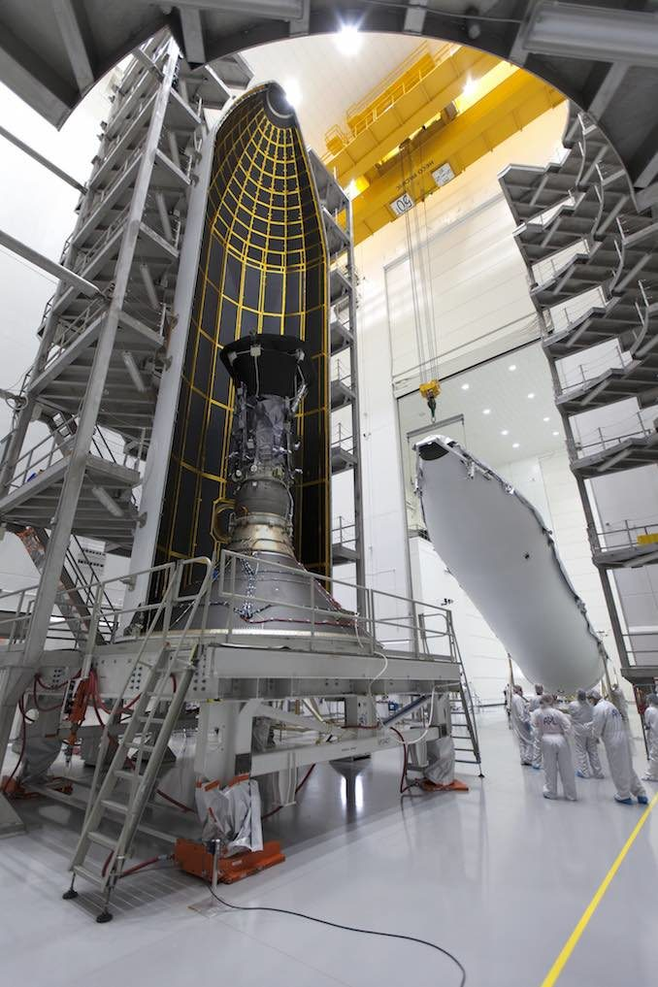
NASA's Parker Solar Probe mission was set off to explore the Sun's atmosphere on Sunday morning August 12, It will swoop to within 6 million km of the Sun's surface, facing heat and radiation like no spacecraft before.
Launch Date: August 12, 2018
Launch Site: Cape Canaveral Air Force Station
Launch Vehicle: Delta IV-Heavy with Upper Stage

Slide 4
Team
Parker Solar Probe is part of NASA’s Living With a Star program to explore aspects of the Sun-Earth system that directly affect life and society.
The Living With a Star flight program is managed by the agency’s Goddard Space Flight Center in Greenbelt, Maryland, for NASA’s Science Mission Directorate in Washington.
The Johns Hopkins University Applied Physics Laboratory (JHU-APL) in Laurel, Maryland, manages the mission for NASA. APL designed, built, and operates the spacecraft.

Slide 5
Mission Objectives
Trace the flow of energy that heats and accelerates the Sun's corona and solar wind
Determine the structure and dynamics of the plasma and magnetic fields at the sources of the solar wind
Explore mechanisms that accelerate and transport energetic particles

Slide 6
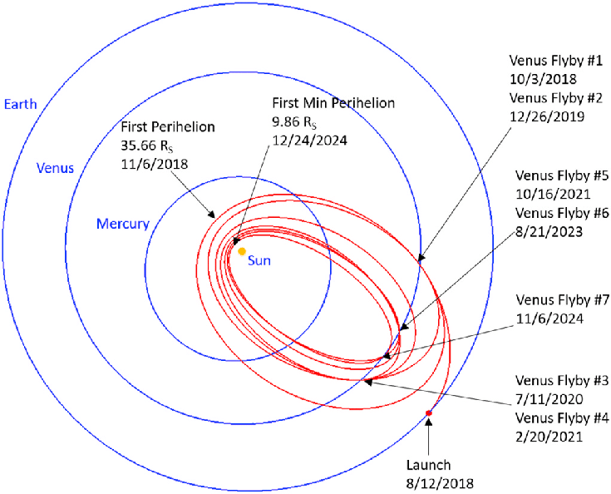
Trajectory Design
The Parker Solar Probe used Venus flybys over nearly seven years to gradually shrink its orbit around the Sun, well within the orbit of Mercury and about eight times closer than any spacecraft has come before.
NASALaunch: August 12, 2018 at 3:31 a.m. EDT (7:31 UTC)Venus Flyby: Oct. 2, 2018 at 7:45pm EDT (23:45 UTC)First Perihelion: Nov. 5, 2018 at 1:33pm EST (18:33 UTC)

Slide 8
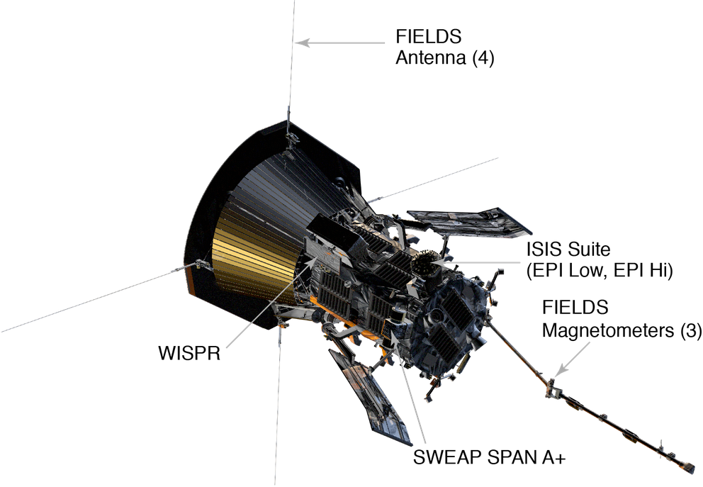
The Spacecraft and Instruments
Fields Experiment (FIELDS)
Integrated Science Investigation of the Sun (IS☉IS)
Solar Wind Electrons Alphas and Protons (SWEAP)
Wide-field Imager for Solar PRobe (WISPR)

Slide 9
FIELDS
Surveyor of the invisible forces, the FIELDS instrument suite captures the scale and shape of electric and magnetic fields in the Sun’s atmosphere. FIELDS measures waves and turbulence in the inner heliosphere with high time resolution to understand the fields associated with waves, shocks and magnetic reconnection, a process by which magnetic field lines explosively realign.
IS☉IS
uses two complementary instruments in one combined scientific investigation to measure particles across a wide range of energies. By measuring electrons, protons and ions, ISʘIS will understand the particles’ lifecycles — where they came from, how they became accelerated and how they move out from the Sun through interplanetary space.

Slide 10
WISPR
The Wide-Field Imager for Parker Solar Probe is the only imaging instrument aboard the spacecraft. WISPR looks at the large-scale structure of the corona and solar wind before the spacecraft flies through it.WISPR takes images from afar of structures like coronal mass ejections, or CMEs, jets and other ejecta from the Sun.
SWEAP
Counts the most abundant particles in the solar wind — electrons, protons and helium ions — and measure such properties as velocity, density, and temperature to improve our understanding of the solar wind and coronal plasma.

Slide 11
Why do we study the Sun and the solar wind?
The Sun is the only star we can study up close. By studying this star we live with, we learn more about stars throughout the universe.
The Sun is a source of light and heat for life on Earth. The more we know about it, the more we can understand how life on Earth developed.
The Sun also affects Earth in less familiar ways. It is the source of the solar wind; a flow of ionized gases from the Sun that streams past Earth at speeds of more than 500 km per second (a million miles per hour).
Disturbances in the solar wind shake Earth's magnetic field and pump energy into the radiation belts, part of a set of changes in near-Earth space known as space weather.
Space weather can change the orbits of satellites, shorten their lifetimes, or interfere with onboard electronics. The more we learn about what causes space weather – and how to predict it – the more we can protect the satellites we depend on.
The solar wind also fills up much of the solar system, dominating the space environment far past Earth. As we send spacecraft and astronauts further and further from home, we must understand this space environment just as early seafarers needed to understand the ocean.

Slide 12
THANK YOU

Slide 13
References and Sources
https://www.nasa.gov/content/goddard/parker-solar-probe
http://parkersolarprobe.jhuapl.edu/The-Mission/index.php
https://commons.wikimedia.org/wiki/File:Animation_of_Parker_Solar_Probe_trajectory.webm

